Slide 1
Sync Project Workshop
Oct 15 2014

Slide 2
Goal
Create a discrete set of requirements and test use cases for the first 6 weeks of the project
Confirm whether or not we want to kick off the project
Upendra $9.08 USD + 8.9% elance charges = $10 USD an hour
Upendra separately pays $10 USD a month to be on the service
If decided to start, determine/document next steps

Slide 3
Conceptual week 1 (20 hours)
Doug
Send Upendra the name of the project by Sat Oct 18
Create a git account for where to put the code by Sat Oct 18
Upendra
Establish a java build and project (maven and git) (Oct 20)
Model the sync tables and basic sync framework (UML models)
Meet up again on Thu Oct 23 at 6am EST

Slide 4
The project goal in as few words as possible
Create common APIs for data synchronization that developers can use to created synchronized data
The first target language is Java. Though, eventually we want interfaces in other languages (most notably Swift using a core data backend for iOS/Mac apps).
We want the APIs to be pluggable from various implementations the way that frameworks like Spring operate (where the developer’s code stays the same but implementations can be changed through configuration of an IoC Container).
Data merging should happen down to the field level (not just record). Merge strategies should be available such as x, y, z
The framework takes into account pluggable sync capabilities like Conflict Resolvers such as UserIntervensionConflictResolver, NamedWinnerConflictResolver, and API for more
Create an implementation that handles sync between (1) database <-> database (2) excel <-> database (3) database <-> excel (4) excel <-> excel
Create a sample compelling application that illustrates the core principles of the framework and implementation patterns

Slide 5
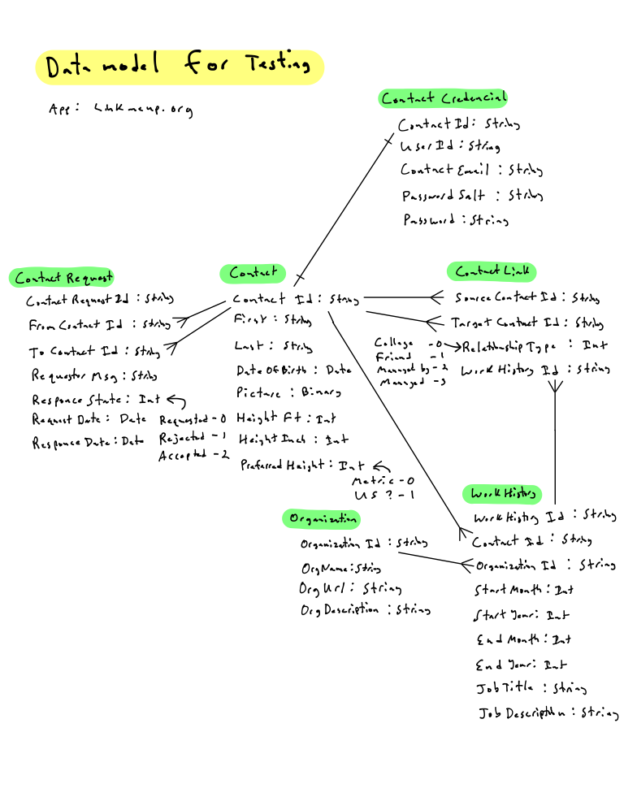

Slide 6
Application Tables
Application Tables
App Code
App Code
jdbc
jdbc
Sync Framework
Sync Tables
Sync Tables
Sync Framework

Slide 7
Application Tables
Application Tables
App Code
App Code
Excel
jdbc
poi
Sync Framework
Sync Tables
Sync Tables
Sync Framework
Sync Cache
Sync Changes Set

Slide 8
Key Constrains
Newly created data must have primary keys must be UNIQUE across data boundaries (practically: no sequential keys, numeric keys are problematic… favor techniques like UUIDs for primary keys)

Slide 9
Order in Processing Matters for relational data
Could walk the relationship tree and look for master tables first for processing and then process leaves
or
The assumption is that the Application Developer tells the framework what order entitles need processing

